Slide 1
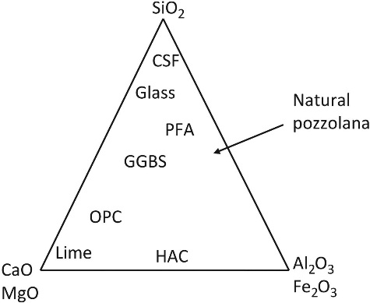
FIGURE 18.1 Schematic Representation of Cementitious Materials

